Slide 1
Lesson 2 – Homework review

Slide 2
Invite all reviewers
olexandr.kucher
y.brahinets
Vrudas
InnaBakum
mudrenko.vlad
michaelsav4enko

Slide 3
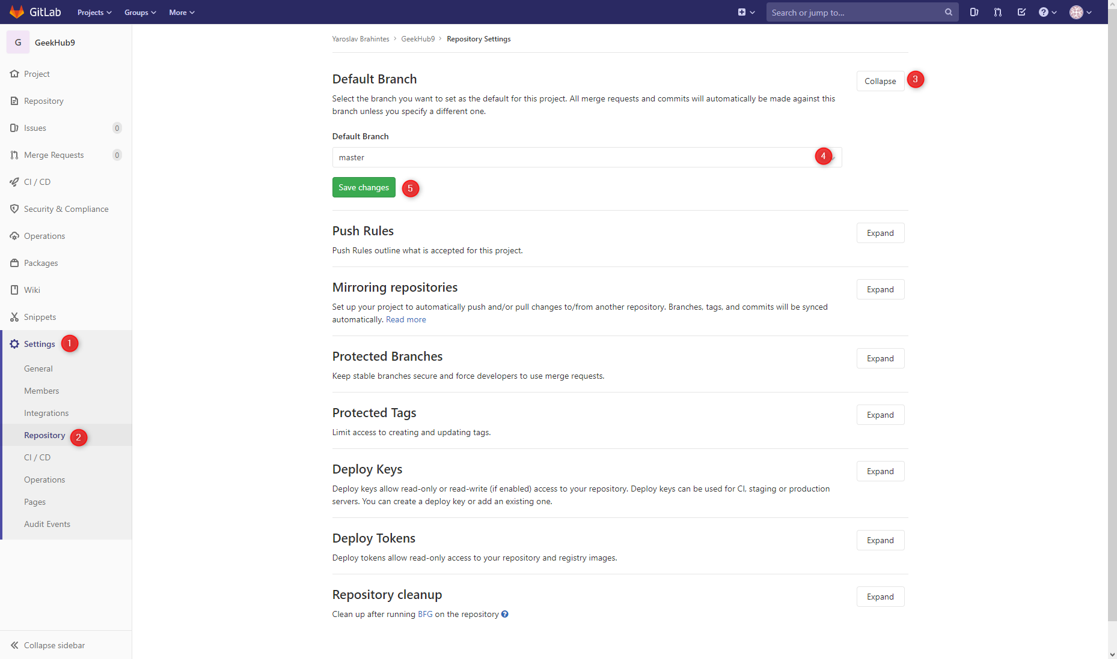
Commit to master but not prod

Slide 4
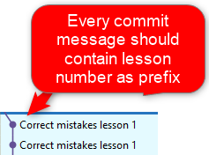
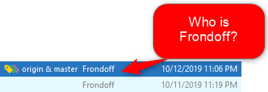

Follow Git convention

Slide 5
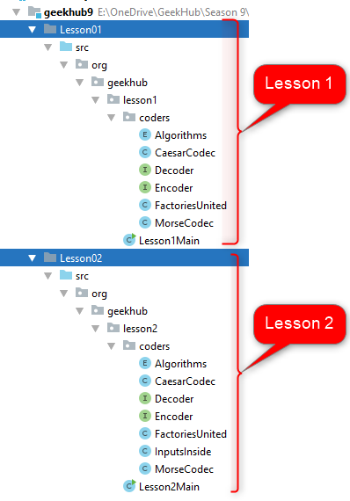
Reuse code

Slide 6
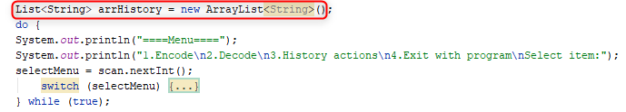
Use only learned features

Slide 7
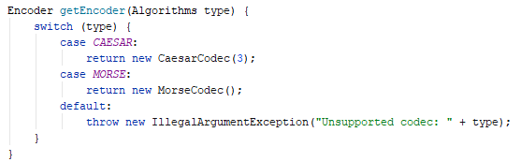

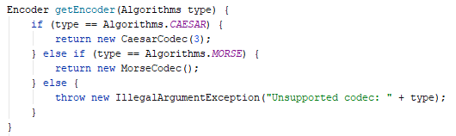
Use braces

Slide 8


Follow naming convention

Slide 9
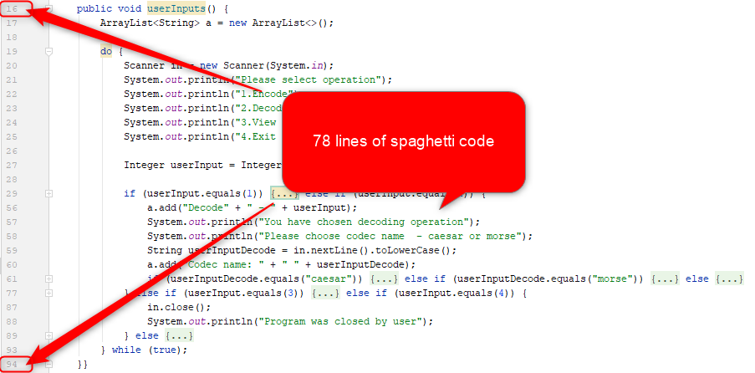
Decompose methods. Keep It Simple

Slide 10
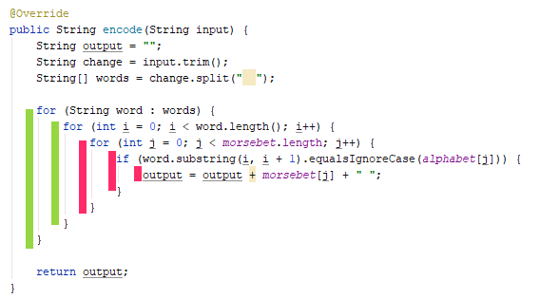
Decompose methods. Keep It Simple

Slide 11
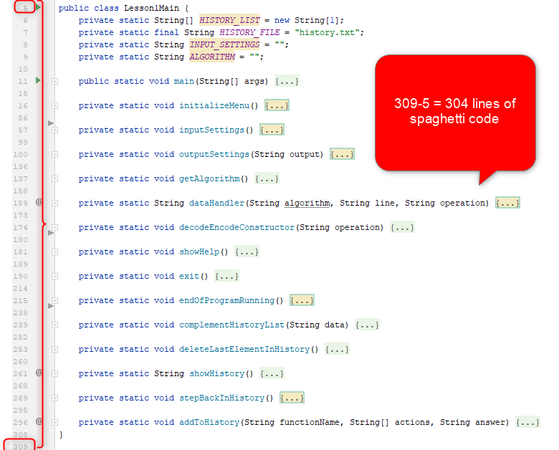
Decompose God-classes. Keep It Simple

Slide 12
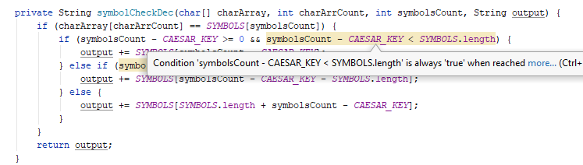
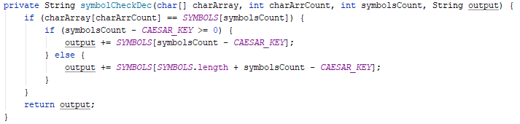
Do not write unreachable code

Slide 13
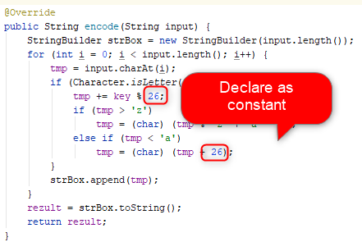
Declare magic numbers as constants

Slide 14
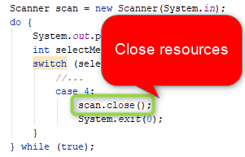
Release resources

Slide 15
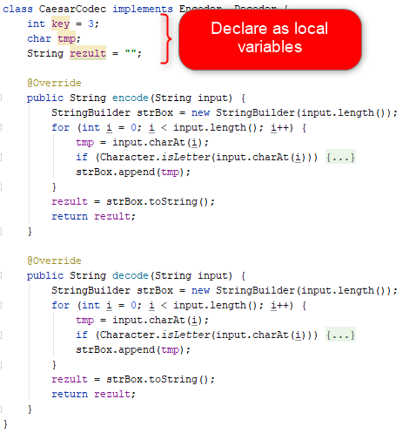
Use the least needed access scope

Slide 16
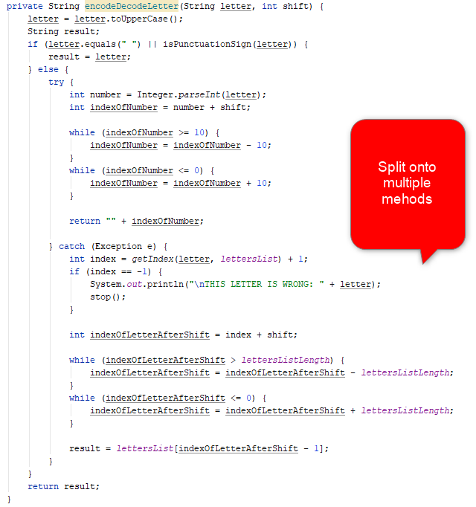
Follow Single Responsibility Principle

Slide 17
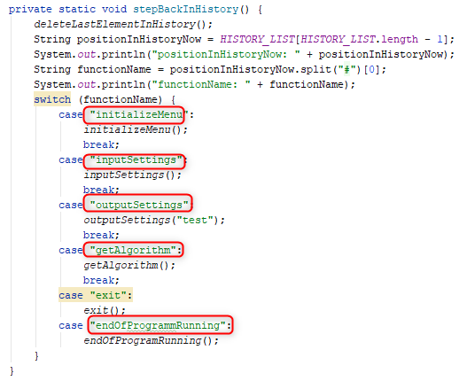
Make user experience friendly

Slide 18

Program should not stop unexpectedly

Slide 19
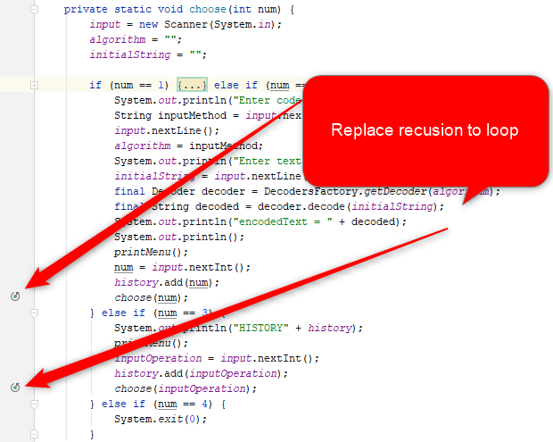
Avoid recursion

Slide 20
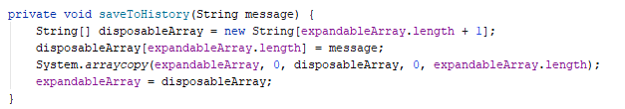
Make program efficient

Slide 21
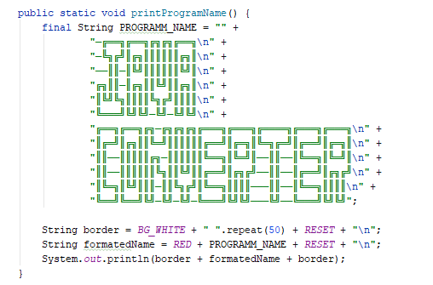
First – make it work; Second – make it clean and clear; Third – make it fast; . . . The last – add svistoprdelky

